Slide 1
Cygnus Strike
By: Weihan and David

Slide 2
Game Overview
basic 2-D space themed shooter
goal of game is to get highest points in time given

Slide 3
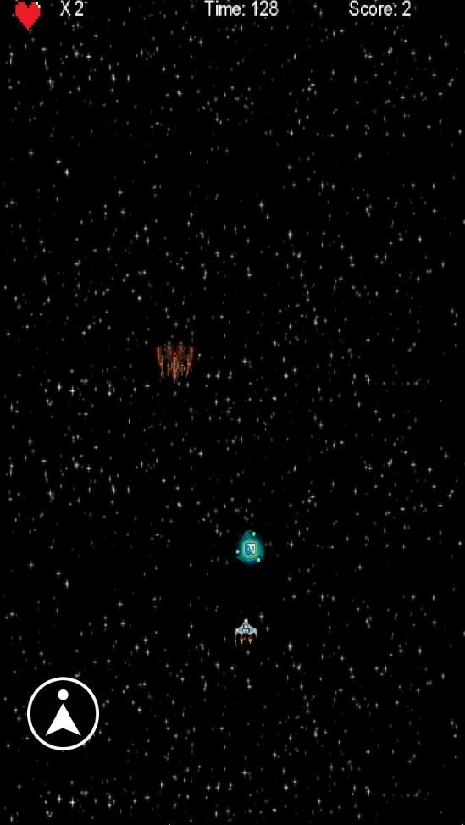
Stock/Lives
Score
Enemy Spaceship
Time Remaining
Power Up
Shoot Button
User’s Spaceship

Slide 4
Release Schedule
Release Name | New incremental features of this release
Awakening 1.1 | Basic Movement: getting an image of a spaceship to follow user’s finger
Awakening 1.2 | Background Movement: setting an image (of space) as the background and getting said background to move vertically down to simulate spaceship movement
Awakening 1.3 | Basic Movement of Obstacles: displaying the obstacles off the top of the screen and moving them straight down to make simulate spaceship movement
Awakening 1.4 | Adding object collision between obstacles & spaceship
Awakening 1.5 | Make spaceship slowly shoot out projectile at timed intervals
Awakening 1.6 | Adding object collision between obstacles & projectile
Awakening 1.7 | Adding in the option of controlling the spaceship by tilt/arrow keys rather than finger movement
Unraveling 1.0 | Adding in stock life system
Unraveling 1.1 | Scoring System: add scoring system & score to currency converting system
Unraveling 1.2 | Items: adding life pack & power-ups (that can be shot to destroy)
Unraveling 1.3 | Buttons v.1: adding bottom left button for power up deployment
Unraveling 1.4 | Items: adding Power-ups and finding a way to store power ups until time of use
*Liquidate 1.0 | Menu v.1/Buttons v.2: add in main menu at start of app, gives 5 options: Start, Settings, Shop, and Exit which are displayed as interactive buttons
Liquidate 1.1 | Menu v.2/Buttons v.3: create a new menu separate from the main menu, this will be the shop menu that incorporates buttons for purchasing upgrades
Liquidate 1.2 | Upgrades/Shop: add upgrades (increases stock of ship, ships damage etc.)
Liquidate 1.3 | Buttons v.4: incorporate a button for in game exiting which will return the user to the main menu (sadly the user will not be able too resume mid level)
Revelations 1.0 | Levels v.1: level limits (have set number of enemies & obstacles, and once depleted the level ends and then the new one begins)
Revelations 1.1 | Levels v.2: increase difficulty as progressing through levels, incorporate auto save onto text file after each level (auto save will include: current player stats & score). As of now there are 10 levels planned. Button will be added to the main menu to contiue
Revelation 1.2 | Levels v.4: allow for the user to resume at last completed level if all stocks are lost
Revelation 1.3 | Display highscore menu after death and after completion of the 10th level Menu: includes highscores, exit button that will return you to main menu
Revelations 1.4 | Graphics: changing appearance of spaceship & spaceship projectiles as upgrades are unlocked

Slide 5
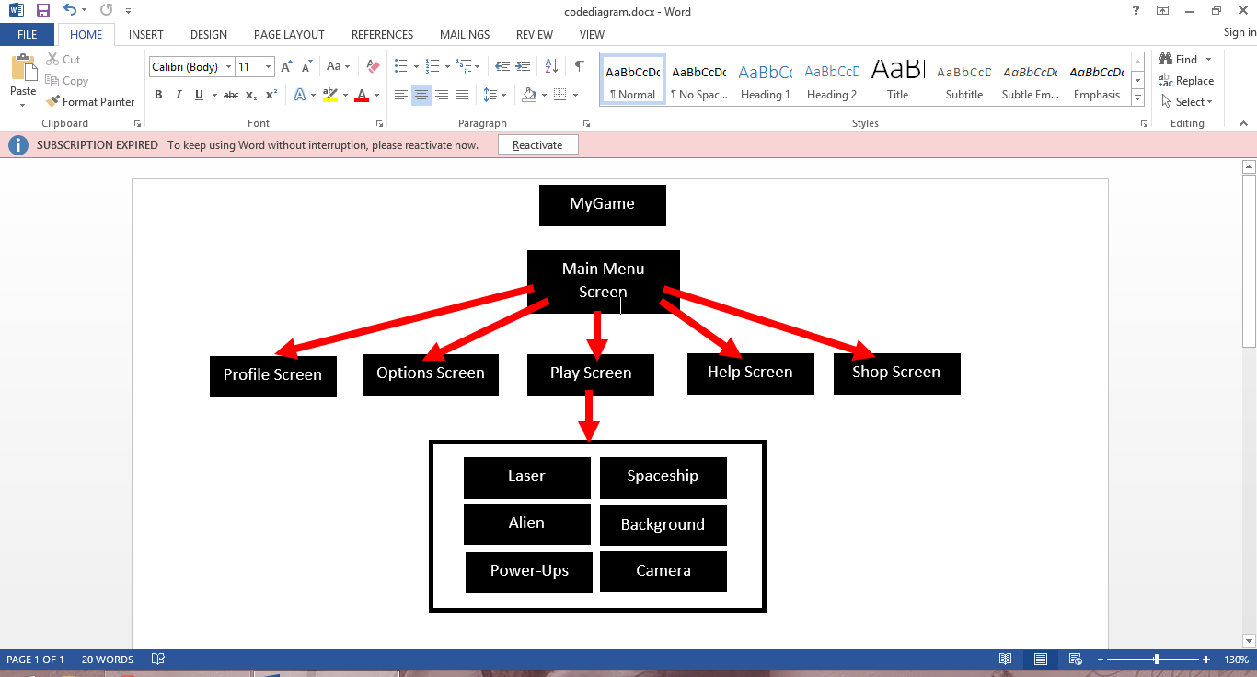
Program Structure
Game Over Screen

Slide 6
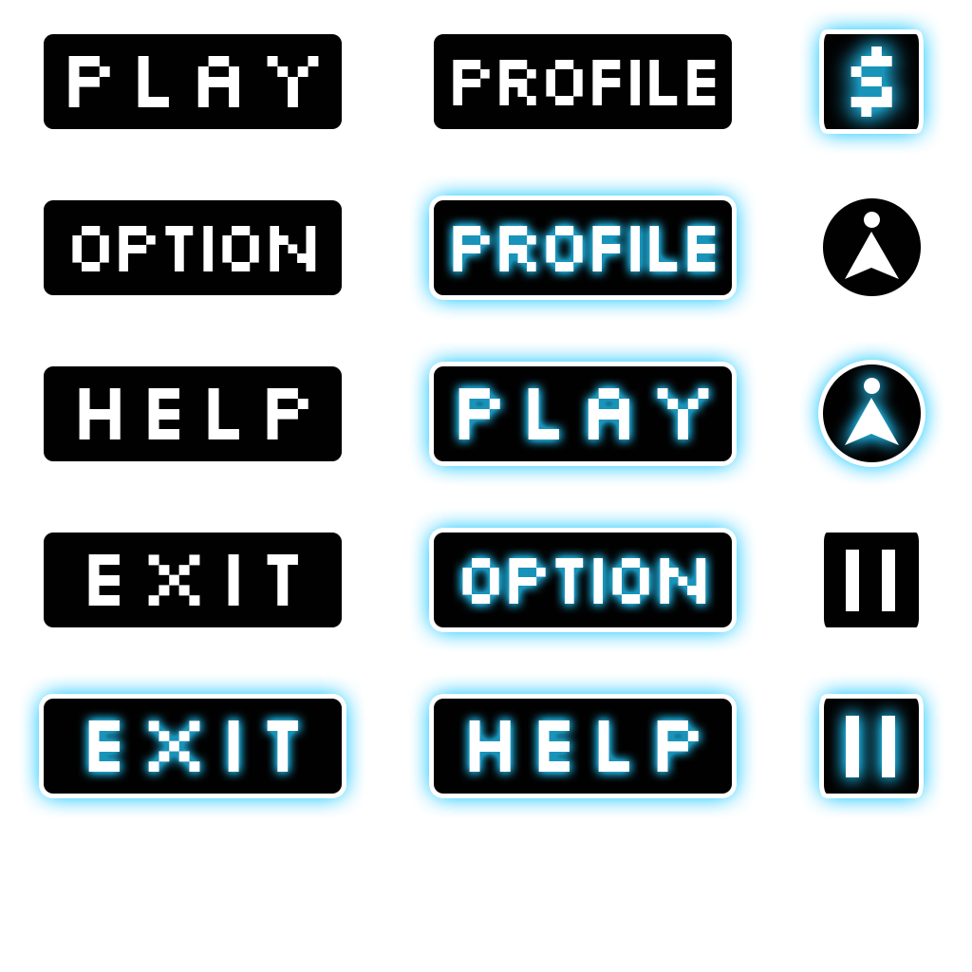
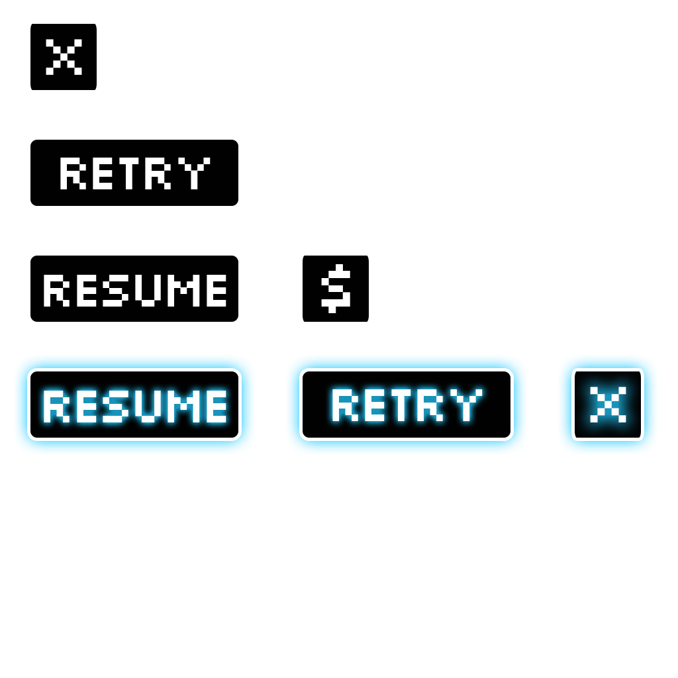
Buttons
TextButtons are given a “graphic” by assigning a TextButtonStyle
Texturepacker creates a spritesheet and a .pack (references) with all the button states
TextButtonStyle references button states from .pack file

Slide 7
Buttons
tbsPlay.up = skinButton.getDrawable("btnPlayUp");
tbsPlay.down = skinButton.getDrawable("btnPlayDown");
tbsPlay.font = fontButton;
btnPlay = new TextButton("", tbsPlay);
btnPlay.addListener(new InputListener() {
@Override
public boolean touchDown(InputEvent event, float x, float y, int pointer, int button) {
return true;
}
@Override
public void touchUp(InputEvent event, float x, float y, int pointer, int button) {
}

Slide 8
The Origin
each screen that is seen (e.g, menu, profile, play) is a class that “implements Screen”
public class MainMenuScreen implements Screen {
an instance of each screen is created in the MyGame class
MainMenuScreen mainMenuScreen;
mainMenuScreen = new MainMenuScreen(this);
it is possible to set the screen that is first seen when the game starts
setScreen(mainMenuScreen);

Slide 9
Changing Screens
a screen is called by using…
game.setScreen(game.profileScreen);
therefore it can be used when conditions are met to change screens (e.g., pressing a button)
public boolean touchDown(InputEvent event, float x, float y, int pointer, int button) {
game.setScreen(game.profileScreen);
return true;
}

Slide 10
Play screen / Main
What does this class do?
lose condition
handles interaction between objects
scoring
collision detection
handles camera
Handle’s Arraylists & iterators

Slide 11
Collision Detection
Checks for overlapping bounding rect of sprites
if(spriteA.getRectA.overlaps(spriteB.getRectB){
do something yay!
}
although there are some limitations with this easy way of doing things, it works for the most part

Slide 12
Lose Condition
Lose Condition #1: Lose all lives if(nStock == 0){ musicPlay.stop(); nStock = 3; fGameTime = 180; nScore = 0; game.setScreen(game.gameOverScreen); } | Lose Condition #2: Game time runs out if(MathUtils.round(fGameTime) == 0 ){ nStock = 3; fGameTime = 180; nScore = 0; musicPlay.stop(); game.setScreen(game.winScreen); }

Slide 13
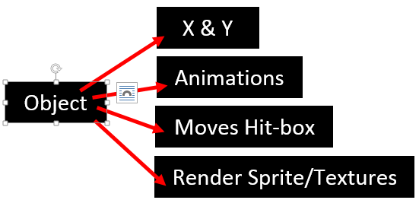
Objects

Slide 14
Rendering & X,Y
X & Y:
-Passing through constructor
public Alien(float fX_, float fY_){
fX = fX_;
fY = fY_;
Rendering:
-accepts and Orthographic camera for device scaling:
public void renderAlien(OrthographicCamera camera_){
-Sets object’s batch projection to Camera’s:
batch.setProjectionMatrix(camera.combined);

Slide 15
Ortho. Camera
Orthographic camera allows for scaling on various sized screens
camMain = new OrthographicCamera();
camMain.setToOrtho(false,1200,800);
the boolean toggles inversion along the horizontal axis of your orientation
the integers set the size that camera views the world at

Slide 16
Controls - Spaceship Object Only
Touch input: public void HandleTouch(){ if (Gdx.input.isTouched()) { Vector3 touchPos = new Vector3(); touchPos.set(Gdx.input.getX(), Gdx.input.getY(), 0); camera.unproject(touchPos); fX = touchPos.x - (fSprite_Width/ 2); fY = touchPos.y - (fSprite_Height/ 2); } | Tilt: public void HandleTilt(){ float fAccelX = Gdx.input.getAccelerometerX(); float fAccelY = Gdx.input.getAccelerometerY(); if(fAccelX>3){ fY += 500*Gdx.graphics.getDeltaTime(); }

Slide 17
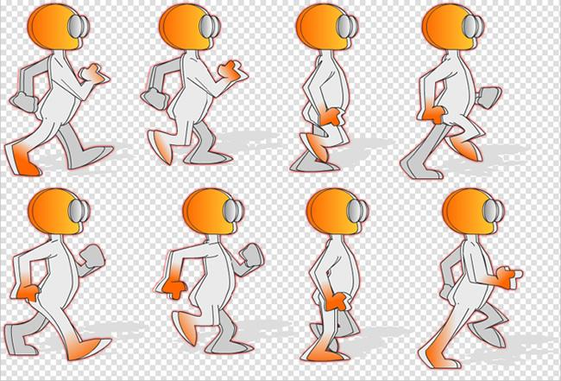
Animations
Animations:
take a sprite-sheet and slice and dice
TextureRegion[][] tmp = TextureRegion.split(imgPowerupSheet,
imgPowerupSheet.getWidth()/nSheetCols, imgPowerupSheet.getHeight()/nSheetRows);
imgFrames = new TextureRegion[nSheetCols * nSheetRows];
int nIndex = 0;
for (int i = 0; i < nSheetRows; i++) {
for (int j = 0; j < nSheetCols; j++) {
imgFrames[nIndex++] = tmp[i][j];
}

Slide 18
Scoring
public static int nScore = 0;
gain points by killing aliens
nScore++
lose time if aliens get past you
fGameTime -=0.5f;

Slide 19
Background
technique works by looping texture from edge to edge
imgBackground.setWrap(Texture.TextureWrap.Repeat, Texture.TextureWrap.Repeat);
texture coordinates go from 0f - 1f
float fScrollTimer = 0.0f;
incrementing scrolltimer for each second that passes (or whatever frame rate render is running at)
float scrollTimer+=Gdx.graphics.getDeltaTime();
resetting timer once it gets to end of texture coordinates
if(scrollTimer>1.0f)
scrollTimer = 0.0f;
setting position of sprite on top of texture (what you’re seeing)
spBackground.setU(fScrollTimer + 2);
spBackground.setU2(fScrollTimer);

Slide 20
Extra - Sounds/Music
initialize as a “Music” variable and reference a file from assets folder
Music musicMainMenu;
musicMainMenu = Gdx.audio.newMusic(Gdx.files.internal("Sounds/MainMenuMusic.mp3"));
musicMainMenu.setVolume(20);
musicMainMenu.setLooping(true);
musicMainMenu.Play();
…
musicMainMenu.Stop();

Slide 21
Bugs
space ship “teleports”
shop button exits the app for some reason
menu music doesn’t stop when loading play screen if another screen was visited previously
sometimes aliens spawn on border of screen
occasional “LSD” mode
the hit-boxes are slightly off but it is ok since we are not mlgs
for some reason background doesn’t show on weihan’s tablet

Slide 22
Challenges/Frustrations
no way to easily rotate BitmapFonts
the github (pushing, pulling, integration with android studio, etc.)
code structure

Slide 23
Lessons
advanced data structures (array list)
proper use of objects

Slide 24
Avd. Data Structures
Iterator<Laser> iterLaser = ArLaser.iterator();
while(iterLaser.hasNext()) {
Laser laser1 = iterLaser.next();// temp var as placeholder
*do stuff to a single laser
if(laser1.updateLaser() == true){//remove the laser
iterLaser.remove();
}
}

Slide 25
Notes to Future Programmers
learn how to use github properly before diving in, ex. learn: terms, structure and functions etc.
don’t let restructuring your code multiple times get to you (it’s worth it)
don’t be afraid to ask your peers for help

